Slide 1

Smart Health And
Wellness Monitoring System
Team-1

Slide 2
INTRODUCTION
The Smart Health and Wellness Monitoring System is an advanced solution aimed at revolutionizing healthcare and wellness management
It enables efficient organization and monitoring of health-related information, ensuring accessibility, transparency, and informed decision-making on a global scale..
With a focus on user-centric design and adaptability, the system fosters seamless collaboration between individuals and healthcare providers.
By promoting better health outcomes and overall well-being, it addresses the growing need for streamlined healthcare solutions worldwide.

Slide 3
Milestones
1
User Authentication
2
Health Data Collection
3
Health Insights & Recommendations
4
Wellness Goals &Tracking
5
Dashboard Visualization & Admin panel

Slide 4
Hardware Requirements
RAM- minimum 4gb/Above
Processor- minimum intel i5 core/Above
Windows- 7/Above
Technology Stack
FRONTEND : HTML, CSS.
BACKEND: Python.
FRAMEWORK : Django Framework.
DATABASE: MySQL.
TOOLS USED: Visual Studio Code, MySQL Workbench.

Slide 5
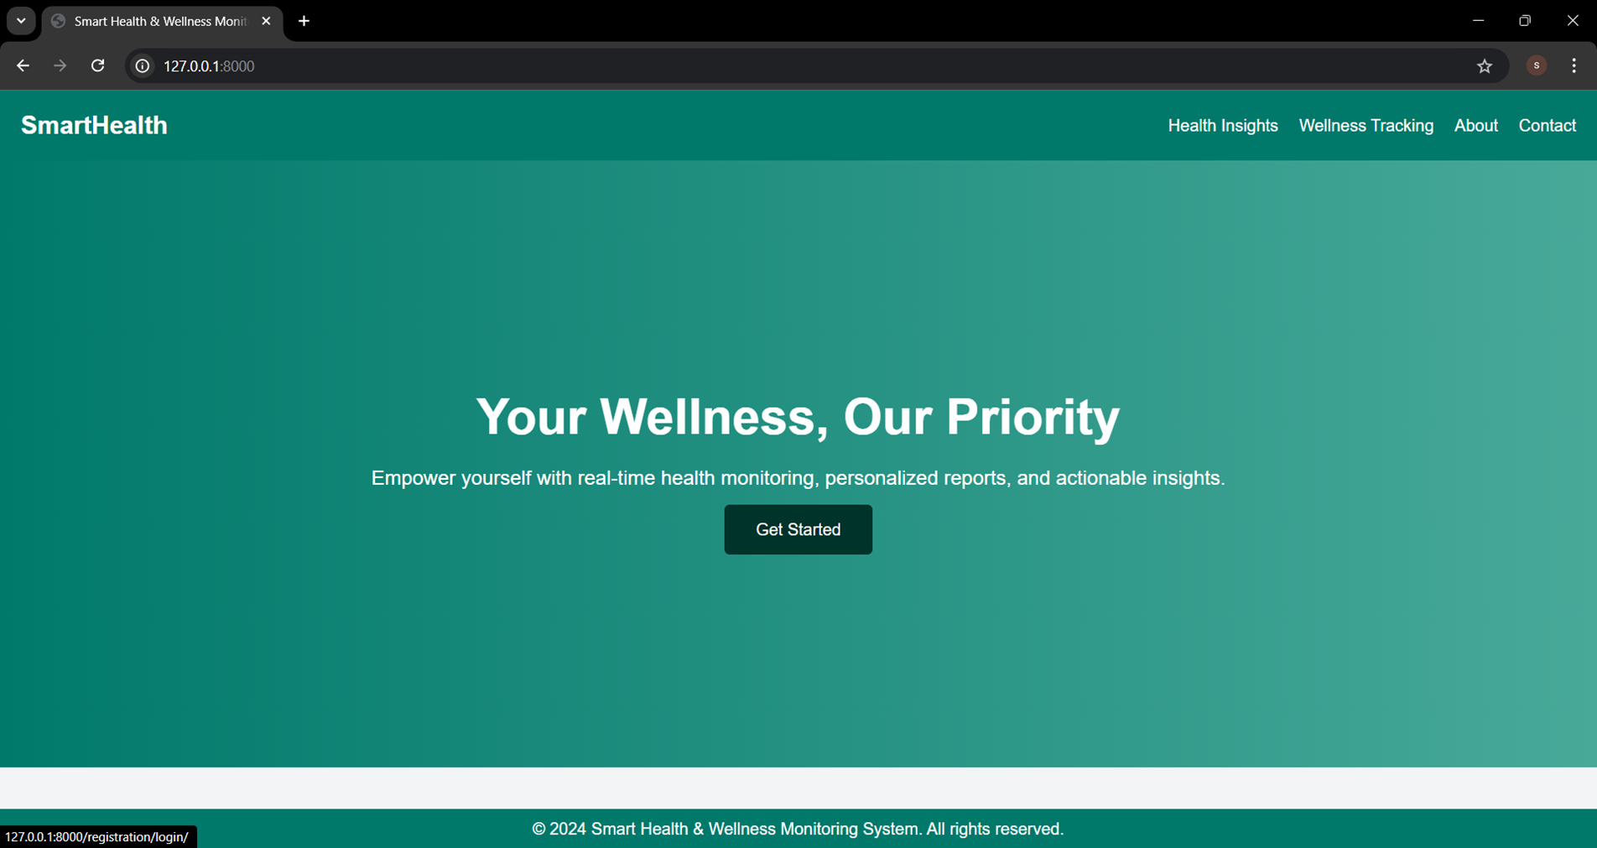
Home Page
The home page serves as the welcoming entry point to our Smart Health and Wellness Monitoring.
The page offers straightforward access with clear options to either log in, sign up, or get started with the platform.

Slide 6

User Authentication
The User Authentication module is designed to ensure secure and reliable access to the system.
It controls user access by validating credentials and allowing authorized users to interact with the platform.

Slide 7
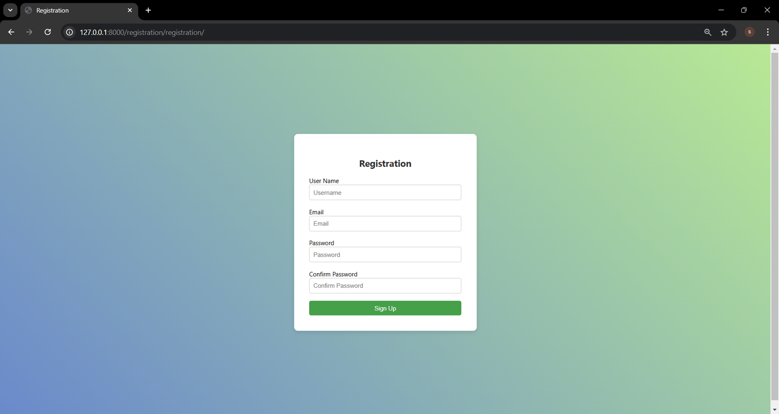
Registration Page
The Registration Page is designed to provide a simple and secure process for new users to join our Smart Health and Wellness Monitoring System.
Here, you can create your personalized account by entering essential details such as your name, email, and password.
Once registered, you’ll gain access, to the full range of features.

Slide 8
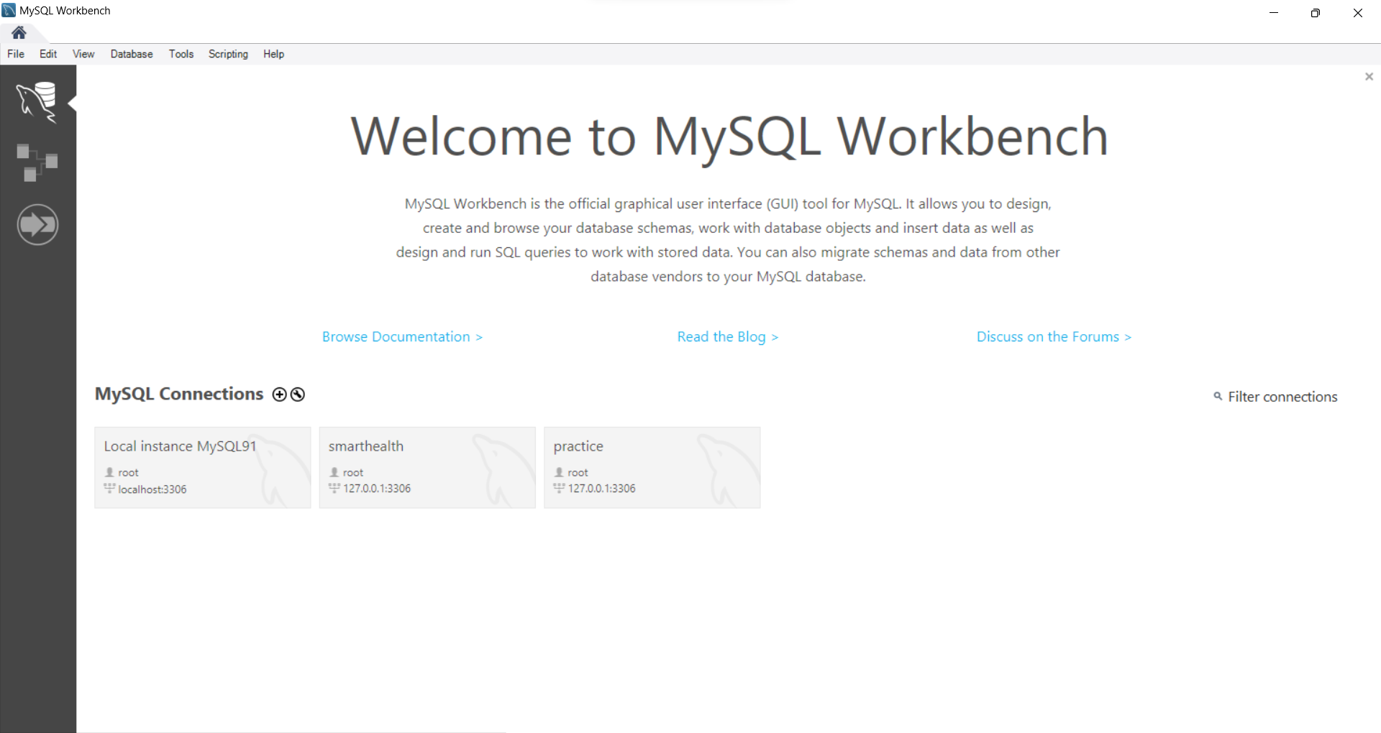
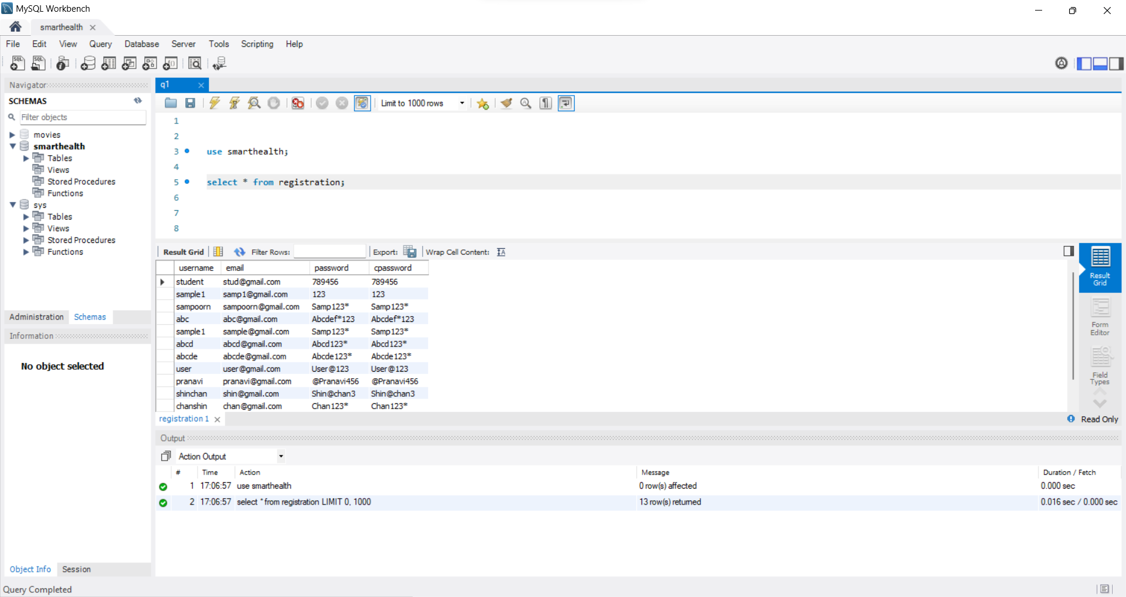
Database

Slide 9
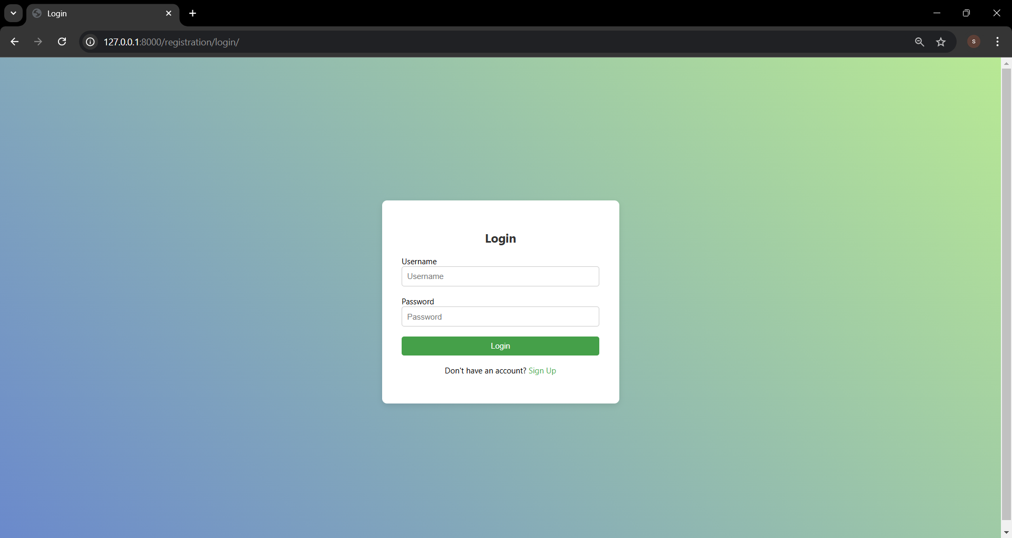
Login Page
The Login Page allows returning users to securely access their accounts and continue their wellness journey.
Simply enter your registered email and password to log in and unlock smart health and wellness features.
If you haven’t registered yet, you can quickly sign up and start your wellness journey today.

Slide 10
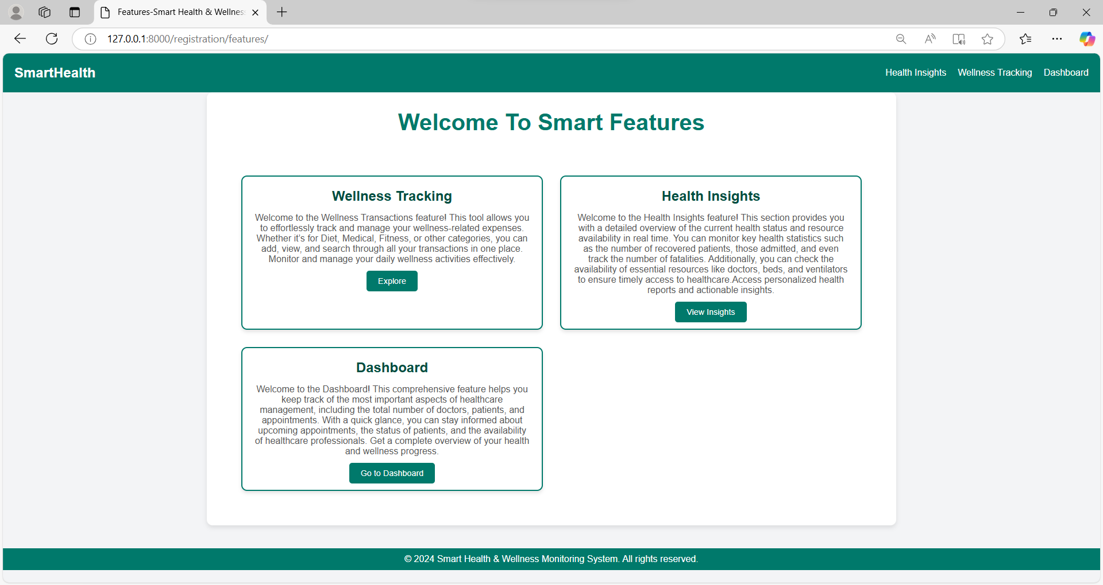
Smart Features
Wellness Transaction Tracking: Seamlessly monitor and manage your wellness-related transactions, from buying
Fitness equipment to medical expenses.
Health Insights: Stay updated on the availability of essential healthcare resources like beds and ventilators, ensuring timely access to care when needed.
Dashboard: A centralized hub to manage your health journey, where you can track patient details, doctor availability, and appointments. This feature simplifies the process of managing appointments .

Slide 11
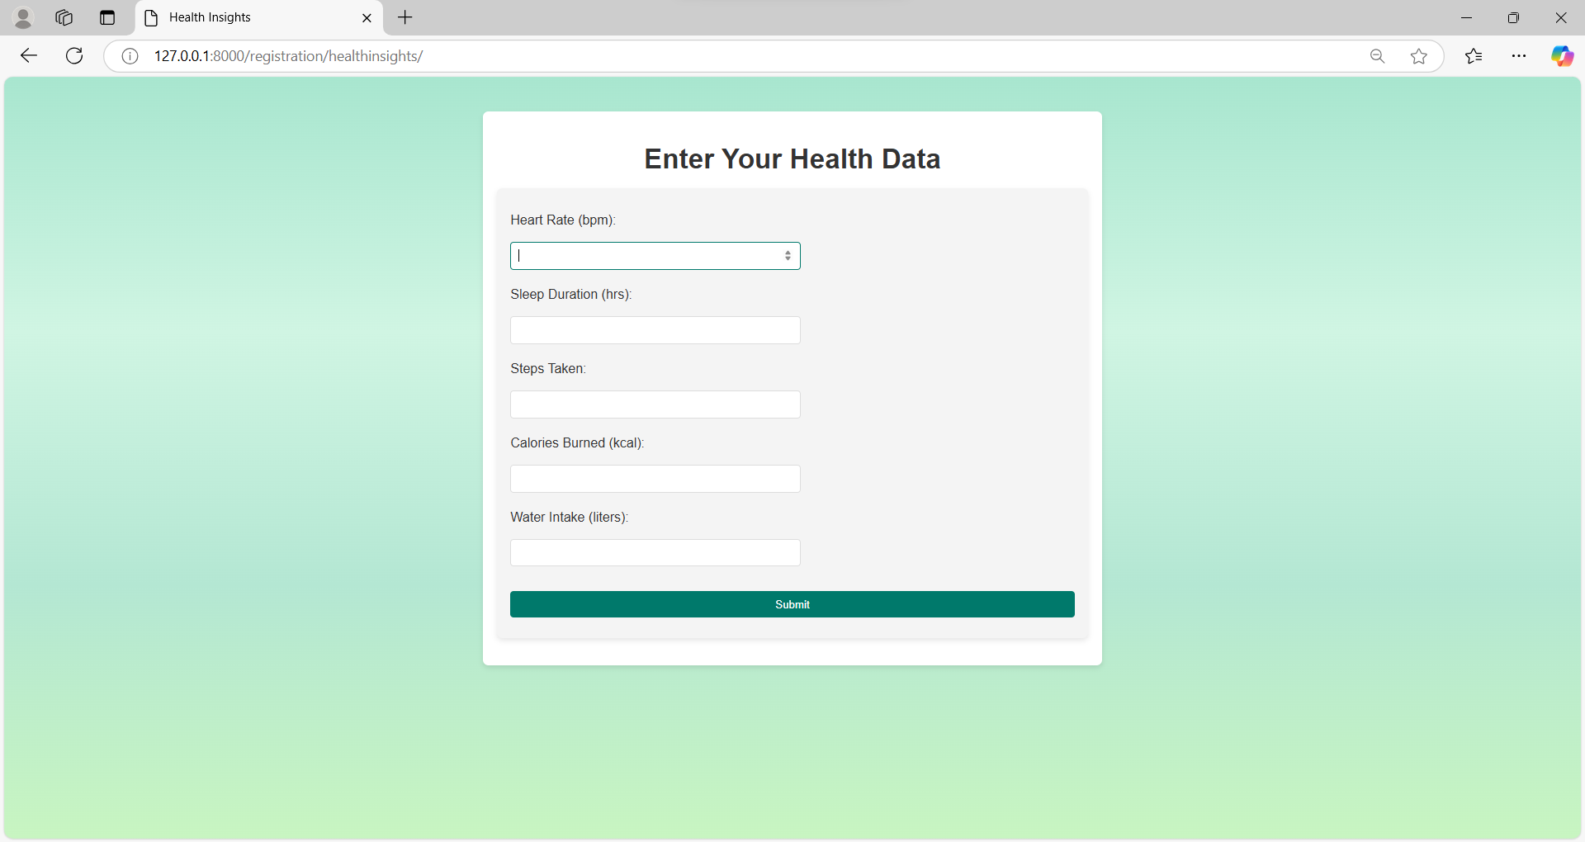
Health Insights
Here, you can view a detailed analysis of your current health metrics, helping you stay on top of your well-being. By tracking key metrics like Heart Rate, Sleep Duration, Steps Taken, Calories Burned, and Water Intake, you can make informed decisions about your health.

Slide 12
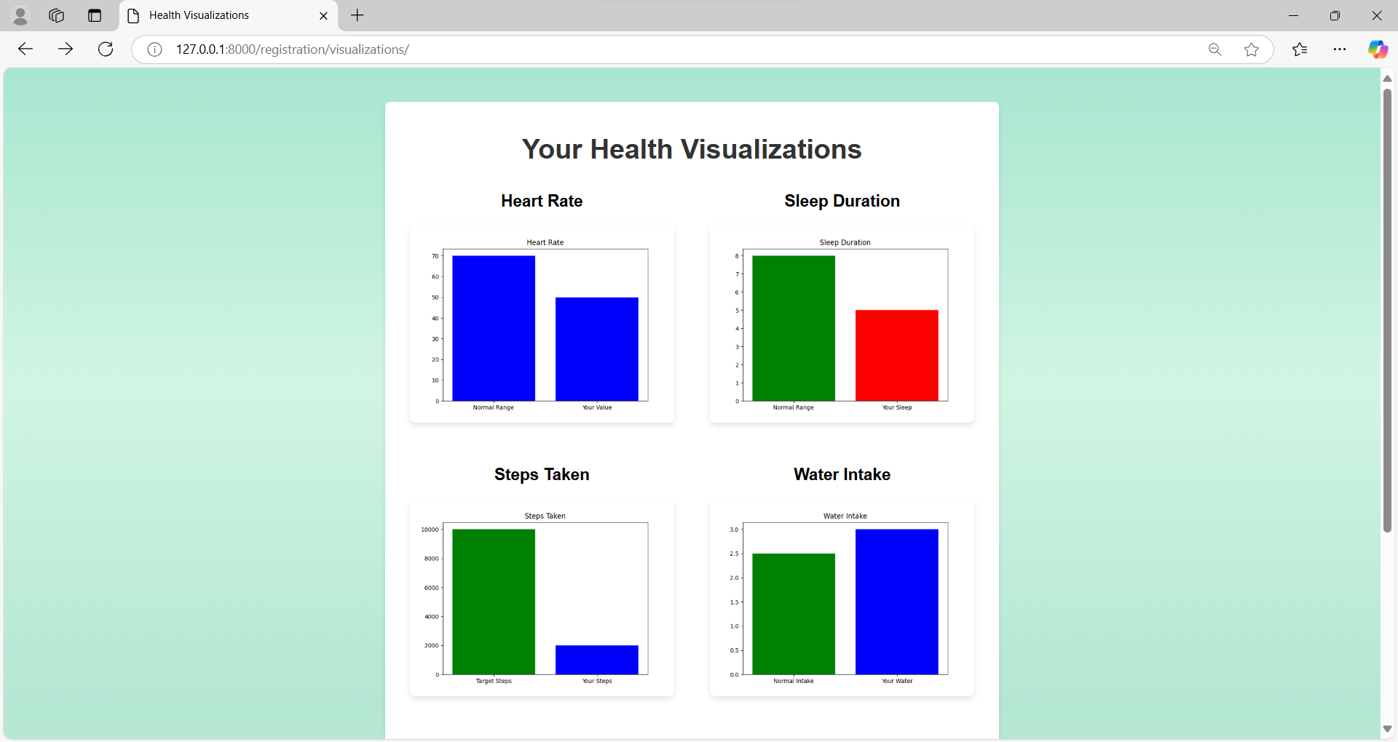
Health Insights-Visualizations
This section provides a way to view and understand your health data. Through visualizations- graphs, you can easily track your progress and see how you’re performing against your health goals.

Slide 13
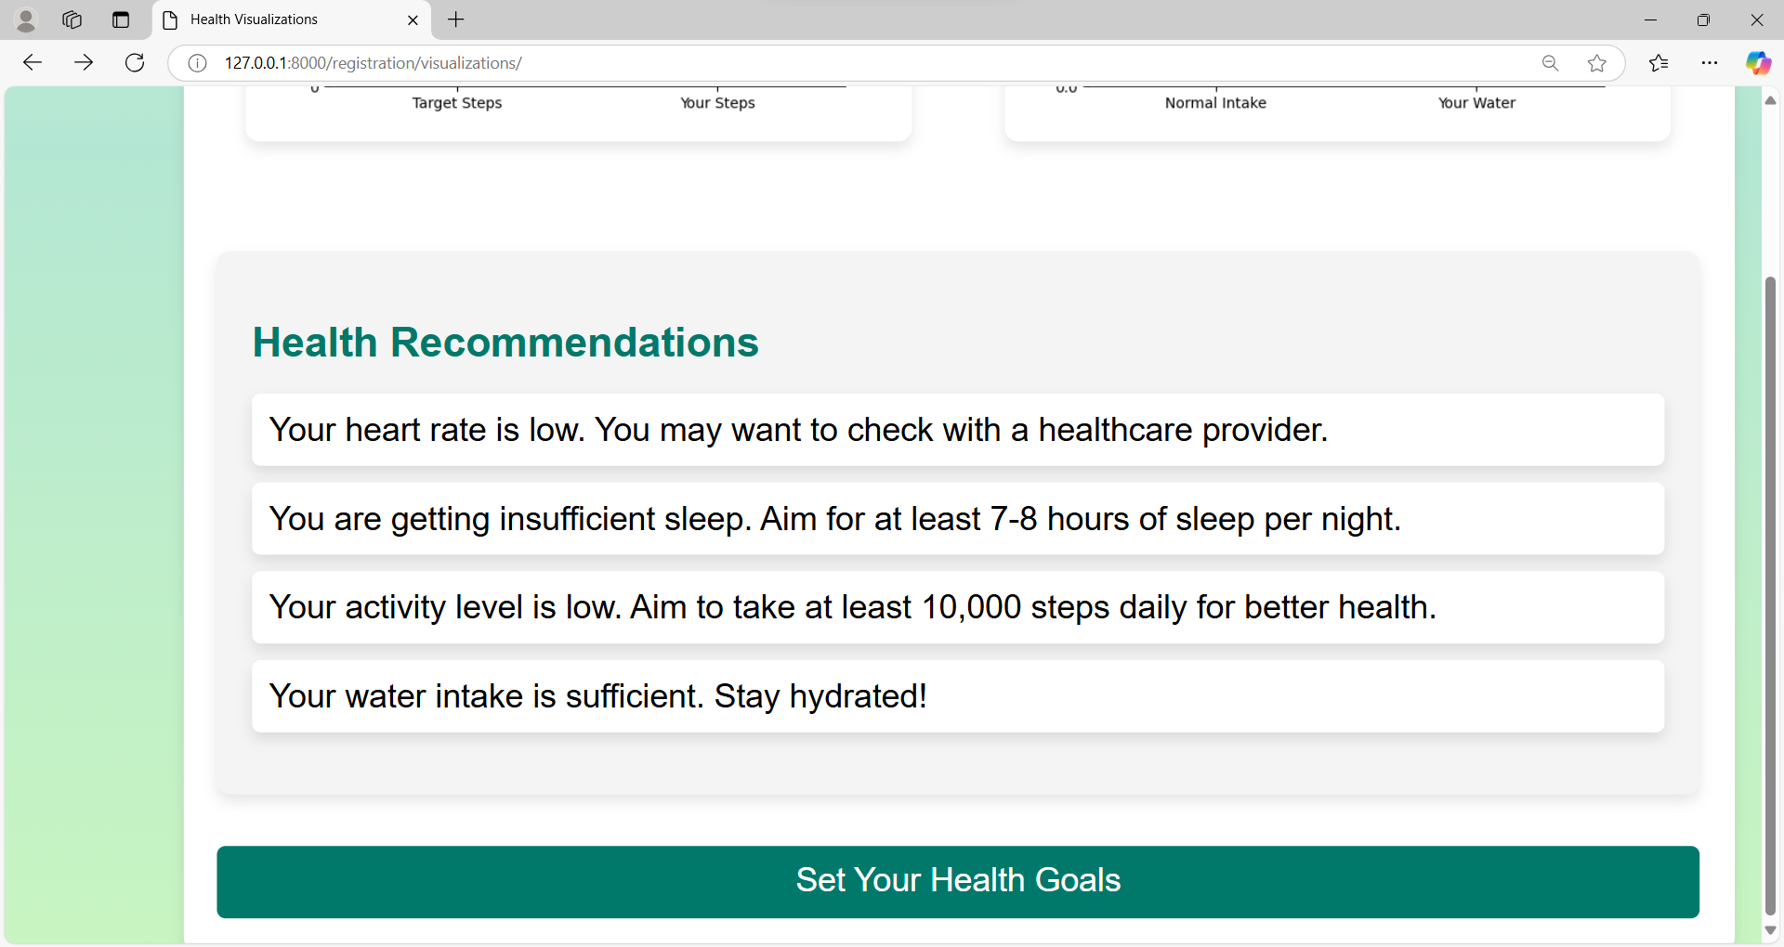
Health Insights-Recommendations
Based on your health data, we provide personalized tips and suggestions to help you improve your overall health and well-being. Our recommendations are designed to motivate you to stay on track with your health goals and to make informed lifestyle changes.

Slide 14
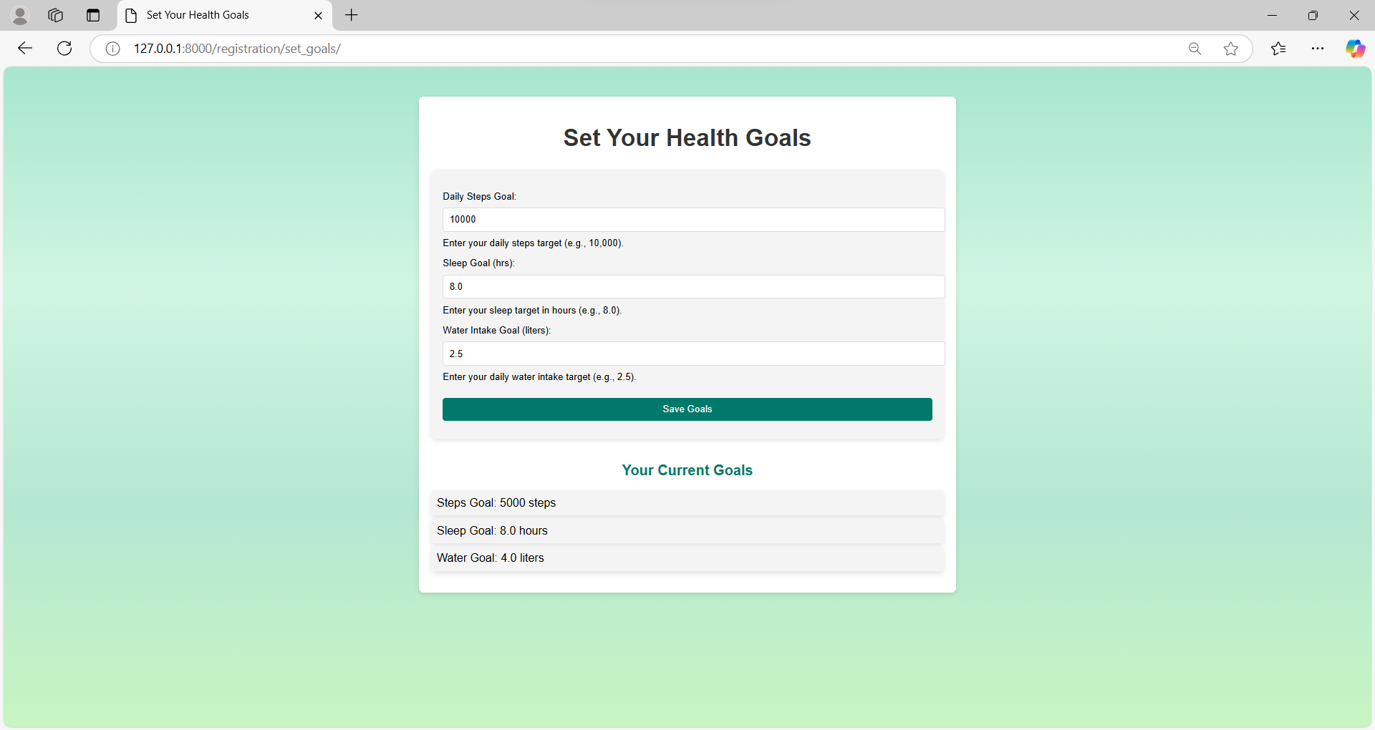
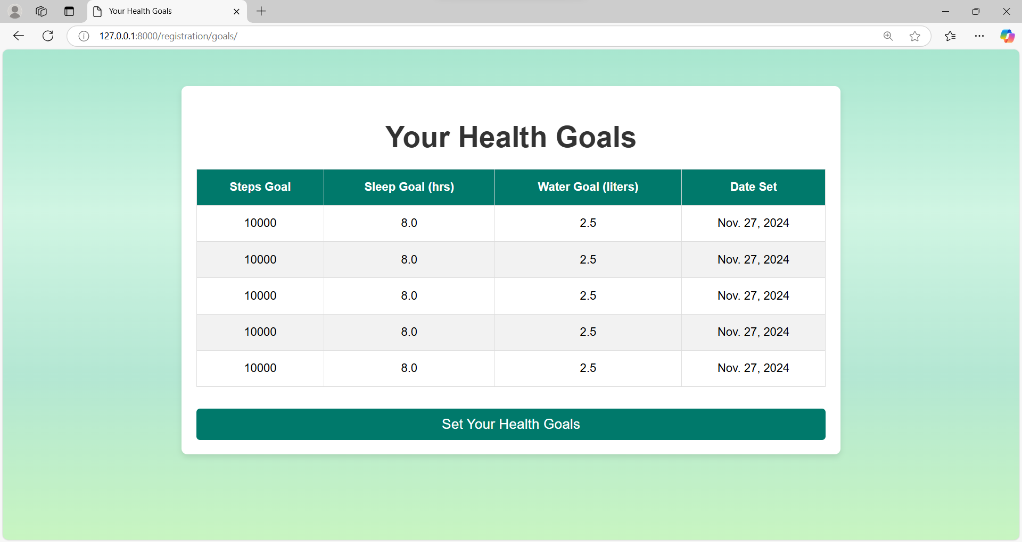
Health Insights-GOALS
Before Setting Goals
After Setting Goals

Slide 15
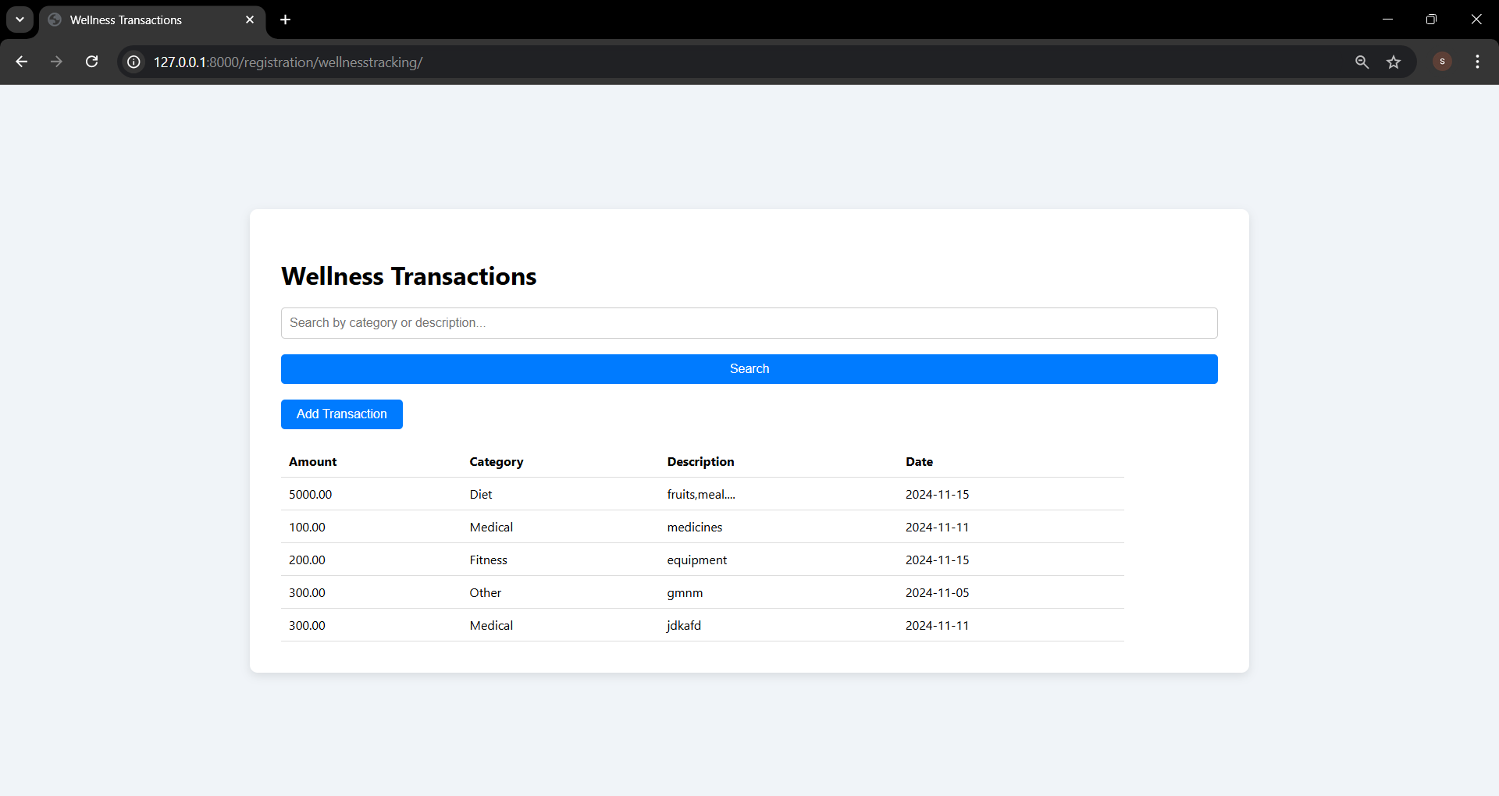
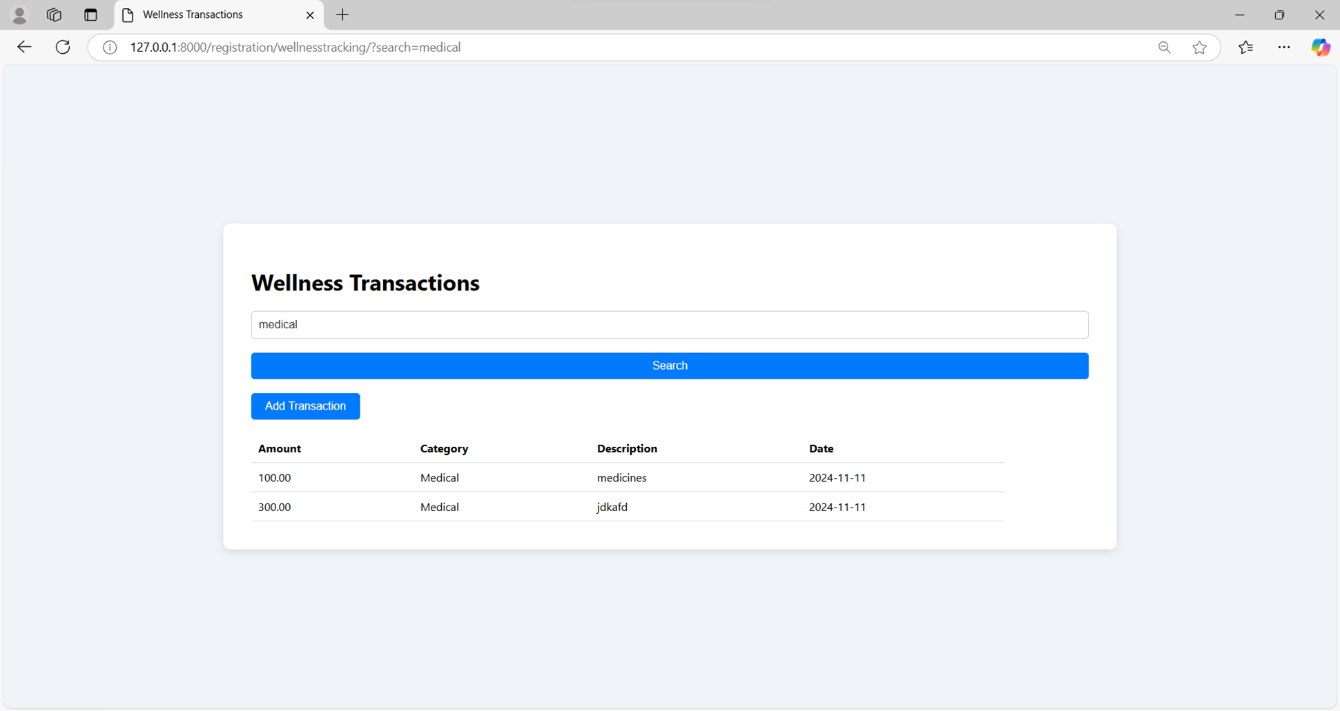
Wellness Tracking
Seamlessly monitor and manage all your wellness-related transactions, from purchasing fitness equipment to tracking medical expenses.
This feature allows you to keep a detailed record of your health-related spending, making it easier to stay organized and within budget.
Can easily search and filter your wellness-related transactions by category or description.

Slide 16
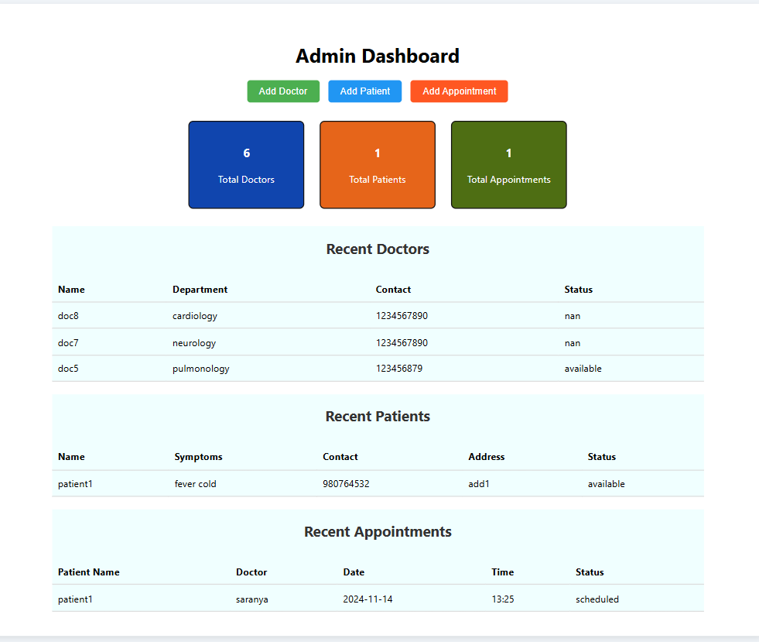

Dashboard
Doctors
Displays information such as contact details, specialization, and availability status to help users quickly identify and connect with the right healthcare professional.
Patients
Highlights key details, including contact information, diagnosed disease, current health condition.
Appointments
Lists upcoming appointments with details like patient and doctor names, date, time, and appointment status (confirmed, pending, or completed

Slide 17
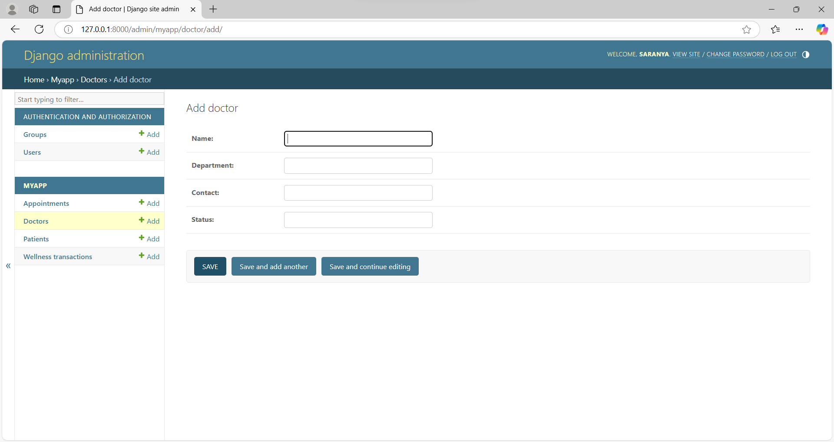
DJANGO ADMIN
The Admin Module allows administrators to efficiently manage the core components of the health and wellness system, including adding patients, doctors, and appointments.
Adding Doctors: The module enables the addition of doctor profiles, including their specialties, availability, and contact information. This ensures that users can easily find and book consultations with qualified healthcare providers based on their needs.

Slide 18
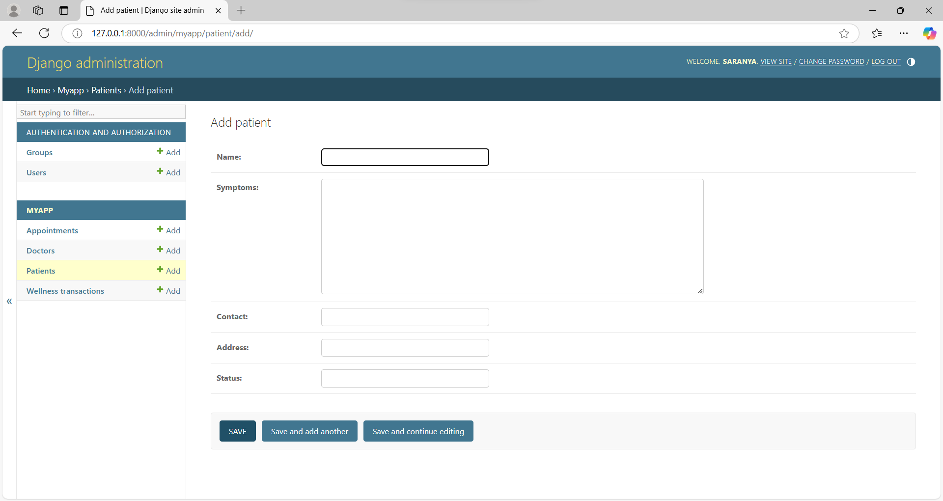
DJANGO ADMIN
Adding Patients: Administrators can easily add new patient profiles by entering essential information such as name, contact details, symptoms This allows for the centralization of patient data, making it accessible for tracking health progress and managing treatments.

Slide 19
DJANGO ADMIN
Adding Appointments: Admins can schedule, modify, or cancel appointments for both patients and doctors. The system allows administrators to view upcoming appointments.

Slide 20
Conclusion
The Smart Health and Wellness Monitoring System effectively integrates real-time health related data with user-friendly features to improve healthcare management.
By providing key insights into healthcare resource availability, tracking health metrics, and offering personalized recommendations, the system empowers users to make informed decisions about their well-being.
With secure user authentication, seamless health data collection, and comprehensive insights into critical resources, the platform fosters better coordination between healthcare providers and users.
Overall, the system enhances accessibility, transparency, and proactive management of health, contributing to better health outcomes and improved wellness.

Slide 21

THANK YOU
TEAM - 1
Saranya Nandyala
Abhinav Reddy Ravula
Sai Vaishnavi Menta
Durairaj
Vyshnavi Namathoti

